Slide 1
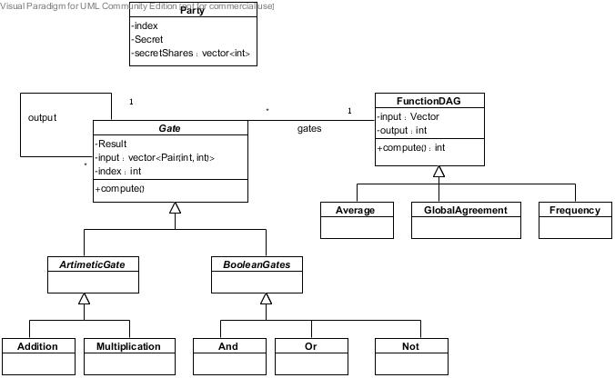
System Design & implementation first design

Slide 2
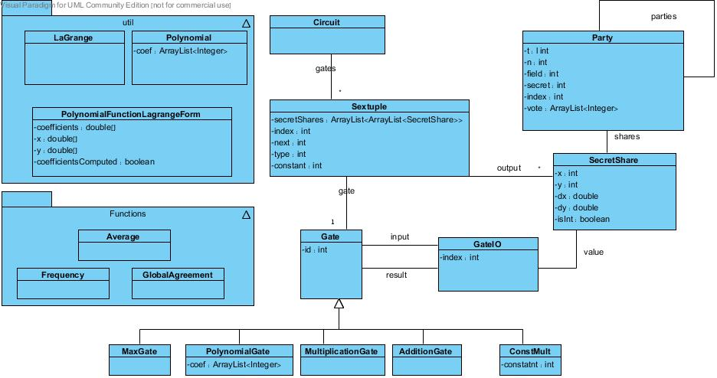
System Design & implementation final design

Slide 3
Graph Representation
Each arithmetic gate is a node in the graph
Directed edge from node A to node B exists if the output of arithmetic gate A is the input of the arithmetic gate B.
Class Node contains:
input vector.
result - the result of the computation.
output vector – vector of nodes(Gates) that will get the result after this computation.

Slide 4
Graph Computation
Define a topological sort on the graph to solve synchronization problems.
Compute the function by the topological order.
Three phases:
Input phase – build t-out-of-n secret sharing for each secret. (known n and t).
Computation phase – compute the graph.
Output phase – construct the output by LaGrange interpolation.

Slide 5
Gates
Arithmetic gates:
using addition and multiplication gates.
input is algebraic representation.
Boolean gates:
using And / Or / Not gates.
input is BitSet Representation.

Slide 6
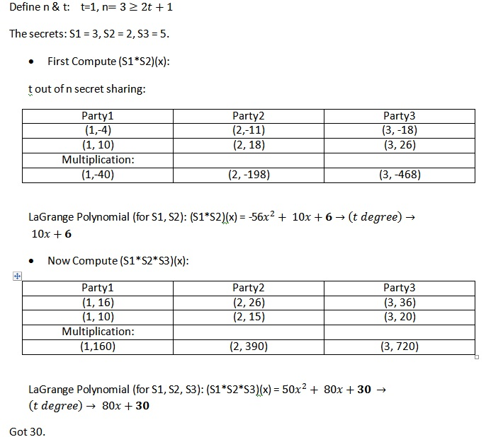
Example

Slide 7
Functions
Average.
Global Agreement.
Frequency.

Slide 8
Average - motivation
Useful for:
Average of a course, without knowing other peoples grades.
Average Salaries in a company, without knowing the other employees salaries.

Slide 9
Average - implementation
Average function represents by arithmetic gates:
level one - Addition gates.
Level 2 – single multiplication gate of level one’s result and constant (1/n).

Slide 10
Average – Example
3 secrets – s1=1, s2=2, s3=3.
T=1, n = 3, field = 7.
secret share for p1 (s1)
[(1,0)(2,6)(3,5)]
secret share for p1 (s2)
[(1,0)(2,5)(3,3)]
secret share for p1 (s3)
[(1,5)(2,0)(3,2)]

Slide 11
Average – Example
Local computation (addition gates):
P1 = [3,5]
P2 = [6,4]
P3 = [2,3]
Result = -54/12 (mod 7) = 6
And the average is 6/3(mod 7) = 2

Slide 12
Global agreement - motivation
Useful for:
For peace in the Middle East.
Global agreements in Business meetings.

Slide 13
Global agreement - implementation
Global Agreement function represents by Boolean gates:
And gates of all inputs.

Slide 14
Global agreement - Example
3 secrets – s1=1, s2=0, s3=1.
T=1, n = 3, field = 7.
secret share for p1 (s1)
[(1,0)(2,6)(3,5)]
secret share for p1 (s2)
[(1,5)(2,3)(3,1)]
secret share for p1 (s3)
[(1,4)(2,0)(3,3)]

Slide 15
Global agreement - Example

Slide 16
Frequency - Motivation
Useful for:
Knowing who is the winner in an election.
(Vector of bits)

Slide 17
Frequency – implementation
Phase 1 – input is Vector of integers. For each element(Candidate) run BGW with sum function.
Phase 2 – input is vector of sum of votes for each candidate. V[i] is the sum for candidate i.
From now on, no party (or t parties) can study anything from the Vector about the original secretes.
Give V to one of the parties. He will calculates the maximum of V.
Phase 3 – input – V(the sum vector), and the maximum. Compare (binary Compare) the maximum for each V[i]. If match found – return i.

